Slide 1
CRIME ANALYSIS Major Project
Muffakham Jah College of Engineering and Technology
Department of Computer Science & Engineering
B.E. VIII SEM(2022-2023)

Slide 2

TEAM MEMBERS
MD MUBEEN ALI ZAKI (1604-19-733-033)
MIR AHMED ALI YASUBUDDIN (1604-19-733-038)
SYED ARFAAT (1604-19-733-051)
Batch-A4
UNDER THE SUPERVISION OF
MRS. MANJUSHA KALEKURI
(ASSISTANT PROFESSOR)
h

Slide 3
TABLE OF CONTENTS
04
01
02
05
03
06
Introduction
System Design
Brief Overview about the domain and Project
System architecture and overview
Literature Survey
Implementation
Existing works study and review
Description of implementation and screenshots
Problem Statement
Testing
Problem and Objectives
Unit Testing, test cases and test on datasets

Slide 4

TABLE OF CONTENTS
07
08
09
Conclusion
Conclusion of the project
Future enhancements
Future Scope
Reference
References for the literature survey

Slide 5
01
Introduction

Slide 6
INTRODUCTION
Crime in India is a major concern for citizens, law enforcement agencies, and policymakers alike.
The country has been grappling with various types of crime, including theft, robbery, assault, and cybercrime.
The increasing crime rate not only affects the safety and security of the citizens but also has a negative impact on the economic development and social fabric of the country.
To address this issue, it is important to analyze crime data and identify crime zones, future crime zone trends, predict crime rates based on projected population and forecast crime rate.

Slide 7
This can help law enforcement agencies to prioritize their efforts and deploy resources more effectively.
In this project, we will explore the crime domain in India, the scope of using Indian crime data for crime analysis, and the potential of ML techniques to aid in the analysis of data so that various strategies can be adopted by the law enforcement agencies that can be deployed to prevent crime and improve the safety and security of citizens.

Slide 8
02
Literature Survey

Slide 9
Literature Survey
SNo. | Title | Strategy | Advantage | Limitation
1. | Crime Analysis and Prediction Using Fuzzy C-Means Algorithm, B. Sivangaleela, S.Rajesh-2019 | Fuzzy C-Means Algorithm to predict the crime rate | It gives the flexibility to express that data points can belong to more than one cluster | Apriori specification of the number of clusters
2. | Crime Prediction Using KNN Algorithm, Akash Kumar, Aniket Verma, Gandhali Shinde, Yash Sukhdeve, Nidhi Lal-2020 | KNN Algorithm to predict the crime rate | There's no need to build a model or tune several parameters | As dataset grows efficiency or speed of algorithm declines very fast
3. | Crime Type and Occurrence Prediction Using Machine Learning Algorithm, ICAIS-2021 | XGBoost, AdaBoost, Random Forest and KNN | The accuracy has been high when compared to other models. | It does not perform so well on sparse and unstructured data

Slide 10
03
Problem Statement

Slide 11

PROBLEM STATEMENT
To identify crime zones by performing Descriptive Analysis on the past data using K-Means and use multiple techniques to perform analysis to understand the alarming increase in crime rate, crime zones.

Slide 12
OBJECTIVES
To build a Web-App that :
Identifies Crime Hotspots (Districts) based on the past data using K-Means.
Predicts future cluster trends for districts based on Estimated Crime Rates (Exponential Smoothing) using Random Forest Classifier.
Predicts the Total IPC Crime for the states based on Projected Population (Geometric Growth Method) using Linear Regression.
Forecasts the Total IPC Crime and Crime Rate of India using fbprophet.
Build dashboards for visualization using Google Charts, Plotly and Choropleth.
Web scrapes crime headlines and plots a heatmap to show the intensity of locations making it to the headlines frequently.

Slide 13
04
System Design

Slide 14
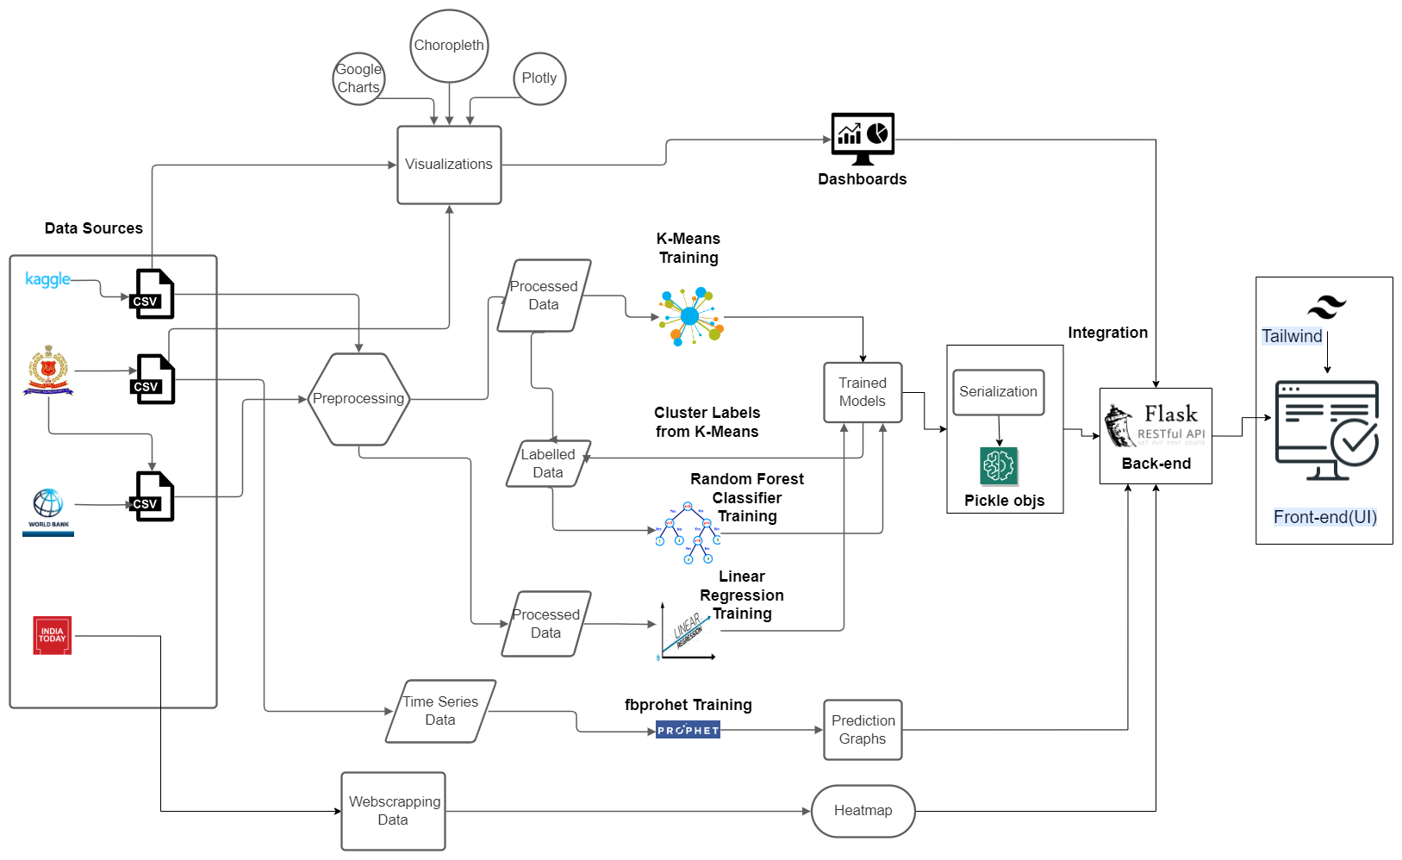
SYSTEM DESIGN

Slide 15
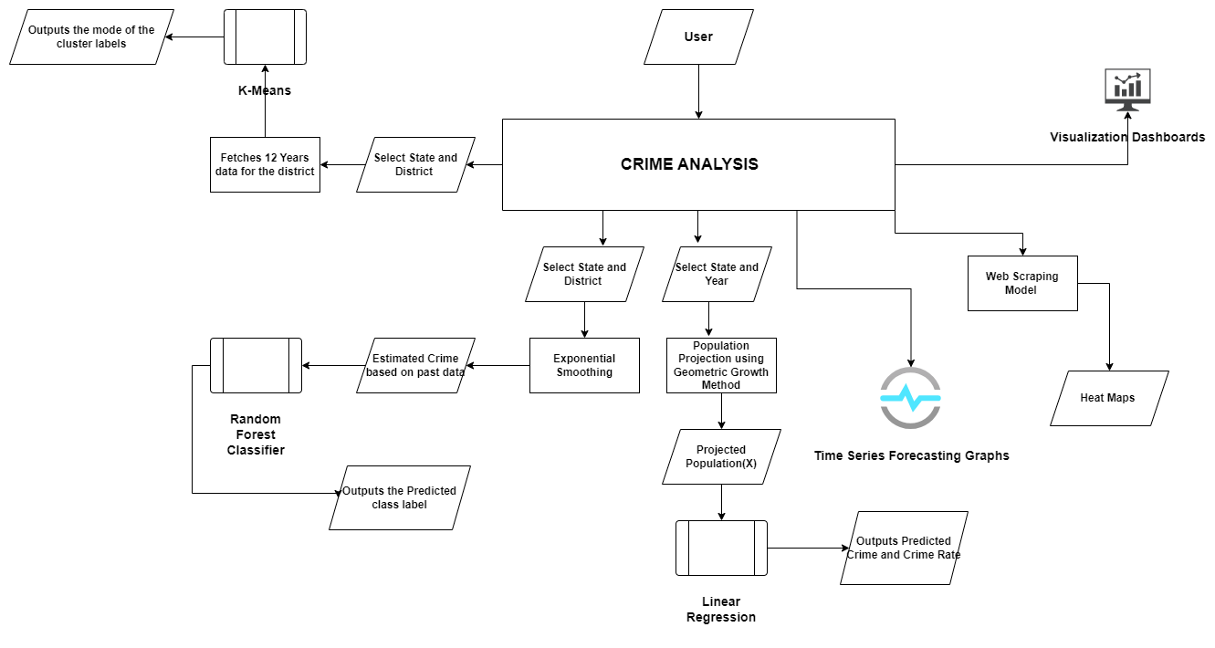
SYSTEM OVERVIEW

Slide 16
05
Implementation

Slide 17
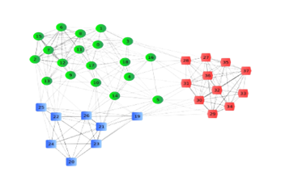
K-MEANS CLUSTERING
Aim : To Identify Crime Hotspots (Districts) by fetching the past data of 12 Years (2001-2012) and calculating the cluster for each year based on the existing clusters using K-Means and return the mode of the cluster list which helps in getting better insights.
Dataset Used : From NCRB
Optimal Number of Clusters = 3 (Elbow Method).
Clusters :
RED ZONE
ORANGE ZONE
GREEN ZONE

Slide 18
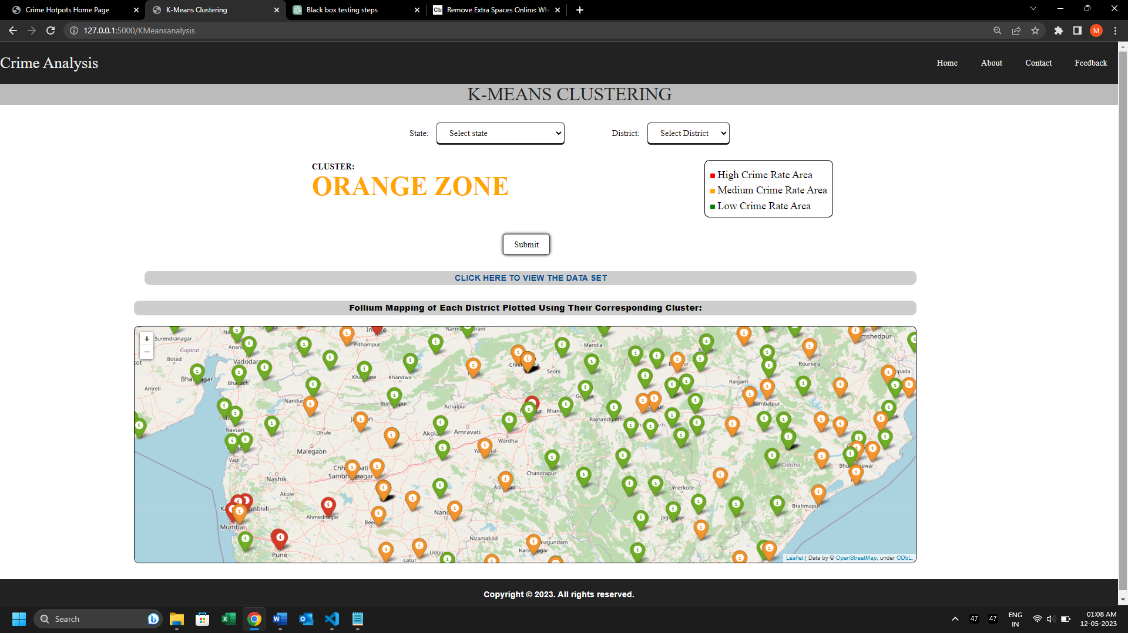
K-MEANS SCREENSHOT

Slide 19

RANDOM FOREST CLASSIFIER
Aim : To Predict future cluster trends for Districts based on Estimated Crime Rates (calculated using Exponential Smoothing based on the past data) using Random Forest Classifier.
Dataset Used : From NCRB (Unlabelled Data) + Cluster Labels from K-Means.
Target Variable(Y): Cluster Label.
Test Size: 0.2 (or) 20%.
Accuracy: 0.9732 (or) 97.32%.

Slide 20
EXPONENTIAL SMOOTHING
Exponential smoothing is a technique used in time series analysis to forecast future values of a variable based on past observations.
Ft = alpha * Yt + (1 - alpha) * Ft-1; where Yt is the actual observation at time t, and Ft1 is the previous forecast.
Smoothing Factor(Weight / alpha) = 0.3
Input to Random Forest Classifier : Estimated Values

Slide 21
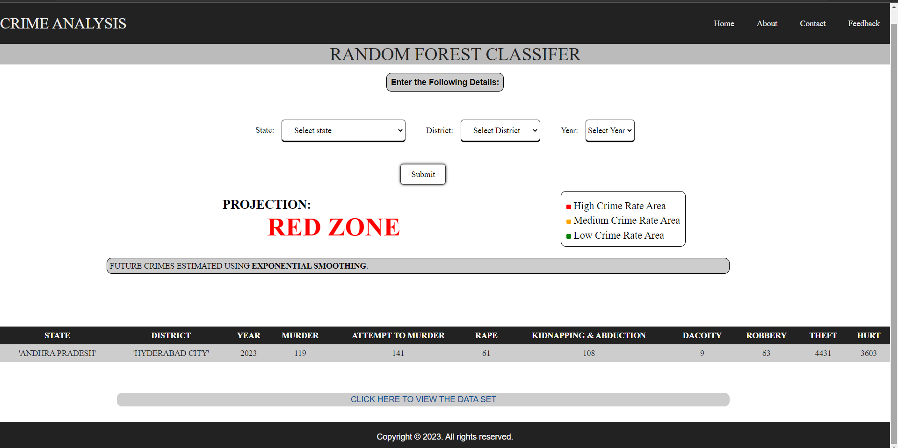
RANDOM FOREST SCREENSHOT

Slide 22

LINEAR REGRESSION
Aim : To Predict the Total IPC Crime for the States based on the Projected Population (Using Geometric Growth Method) using Linear Regression.
Dataset Used : 2001 – 2019 India (State Level) Total IPC Crime Dataset from NCRB.
Correlation(Population, Crime Count) : 0.8274
Independent Variable(X): Population(in Lakhs)
Dependent Variable(Y): Crime Count.

Slide 23

POPULATION PROJECTION
Population Projection using geometric growth method is a way of predicting the future population of a particular area
Assumption : Population will continue to grow at a constant rate over a given period.
Formula : Nt = N0 * (1 + r)^t ;where Nt is the estimated population at time t, N0 is the initial population, r is the annual growth rate expressed as a decimal or percentage, and t is the number of years into the future
Input to Linear Regression : Projected Population (in Lakhs).

Slide 24
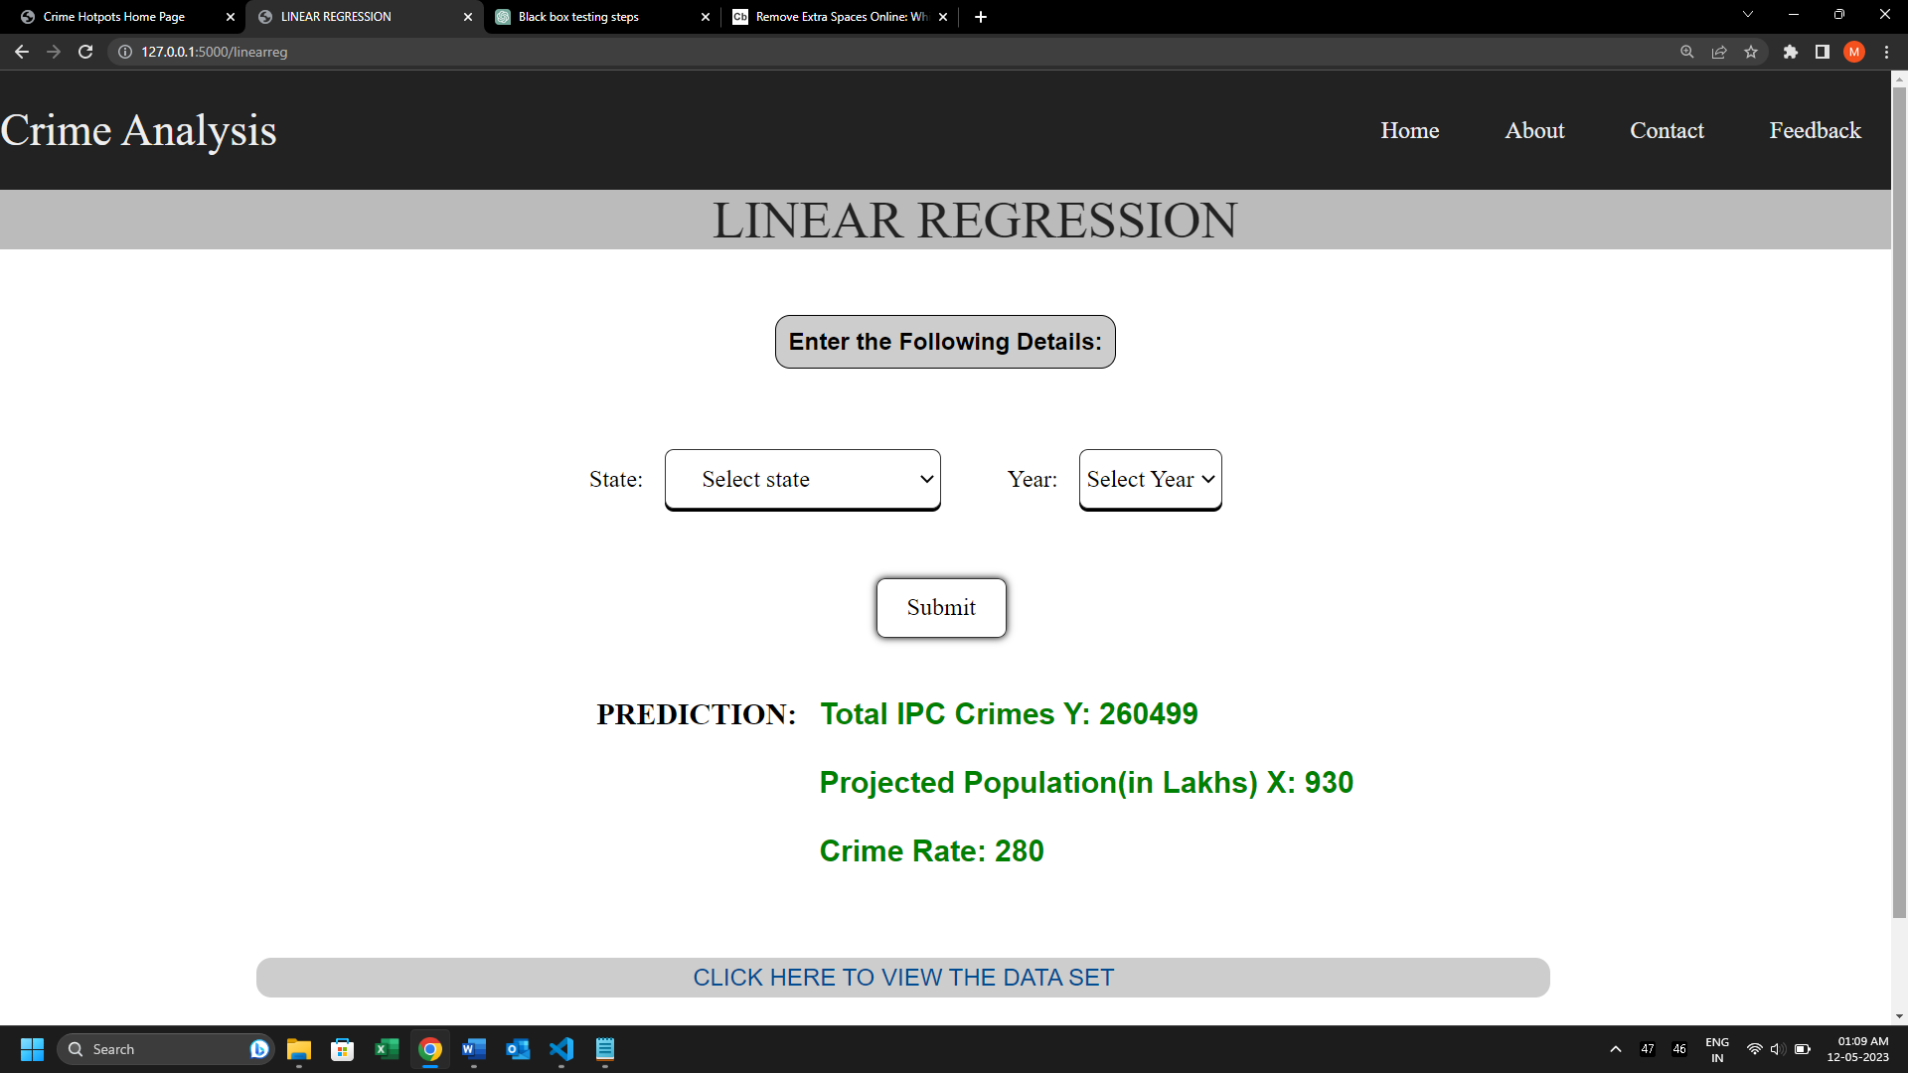
LINEAR REGRESSION SCREENSHOT

Slide 25
Time Series Forecasting
Aim : To Forecast the Total IPC Crime and Crime Rate of India for the next 5 years using fbprophet.
Dataset Used : 1981 – 2021 India Total IPC Crime and Crime Rate Data from NCRB.
Time Series (ds): Year
Variable: (i) Total IPC Crime(y)
(ii) Crime Rate(y)
Accuracy(For Crime Rate): 0.8885 (or) 88.85 %.
Accuracy(Total IPC Crime): 0.9666 (or) 96.66 % .

Slide 26
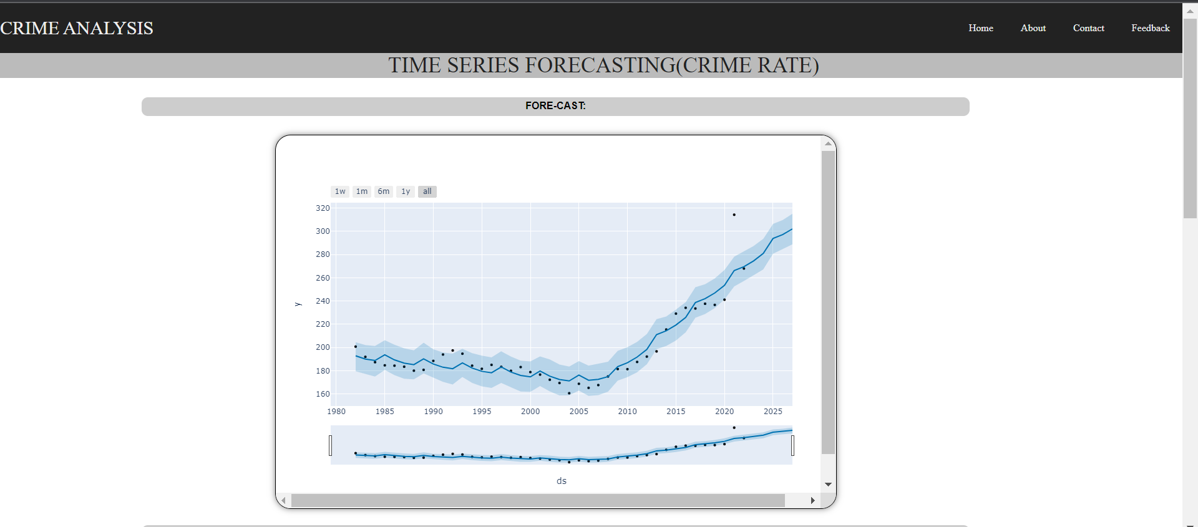
Time Series Forecasting SCREENSHOT
Crime Rate:

Slide 27
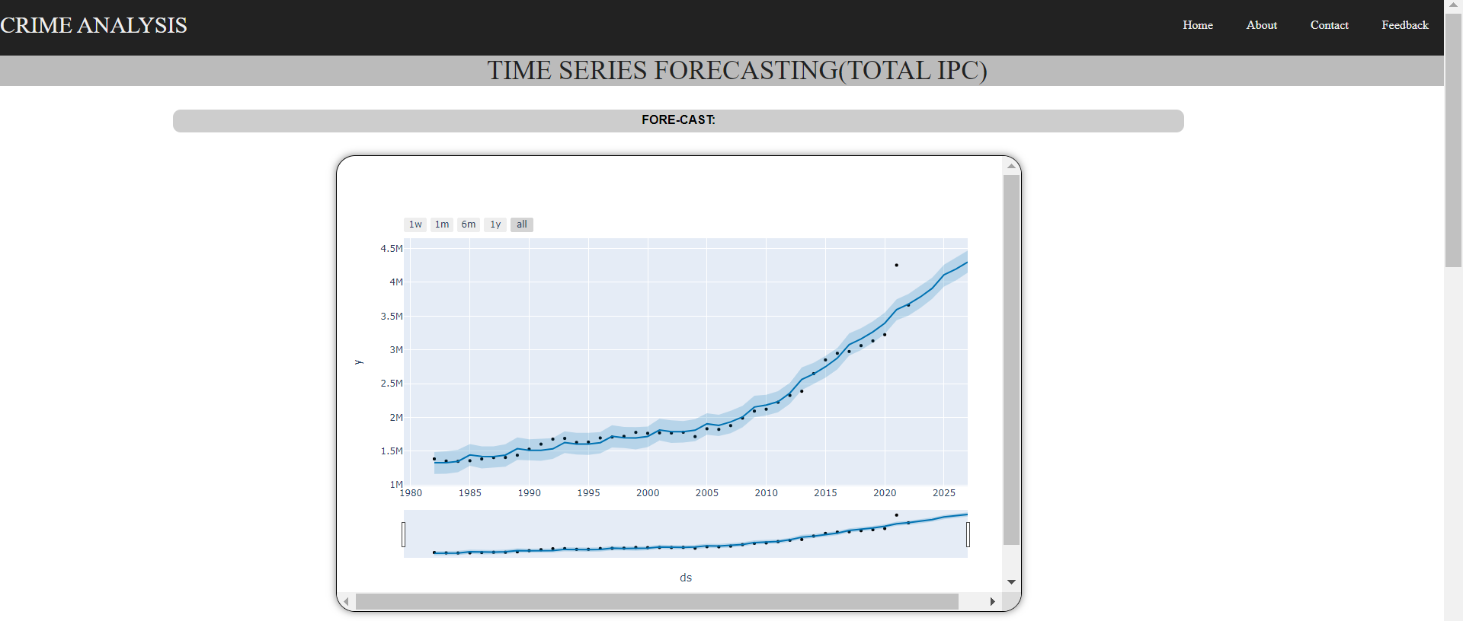
Time Series Forecasting SCREENSHOT
Total IPC:

Slide 28
VISUALIZATION DASHBOARDS
Aim : To build Visualization Dashboards using Google Charts, Plotly and Choropleth to visualize large volume of data in the simplest possible way to better analysis
Dataset Used :
(i) 2001-12 India (State Level) Dataset from NCRB (For Google Charts)
(ii) 2001-19 India (State) Dataset from NCRB (For Plotly and Choropleth).
Libraries Used :
Google Charts (For Bar Charts and Line Charts)
Plotly (For Multi-Linear, Stacked-Bar and Grouped Bar)
Choropleth (For Geospatial Visualization)

Slide 29
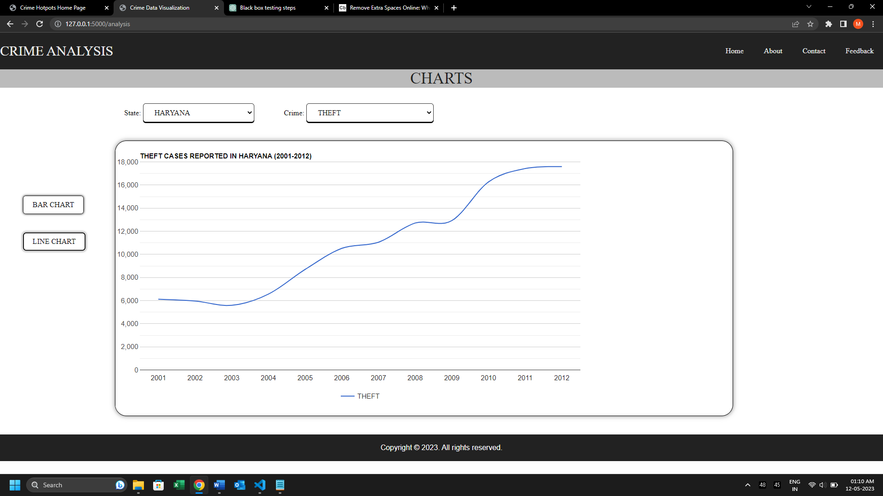
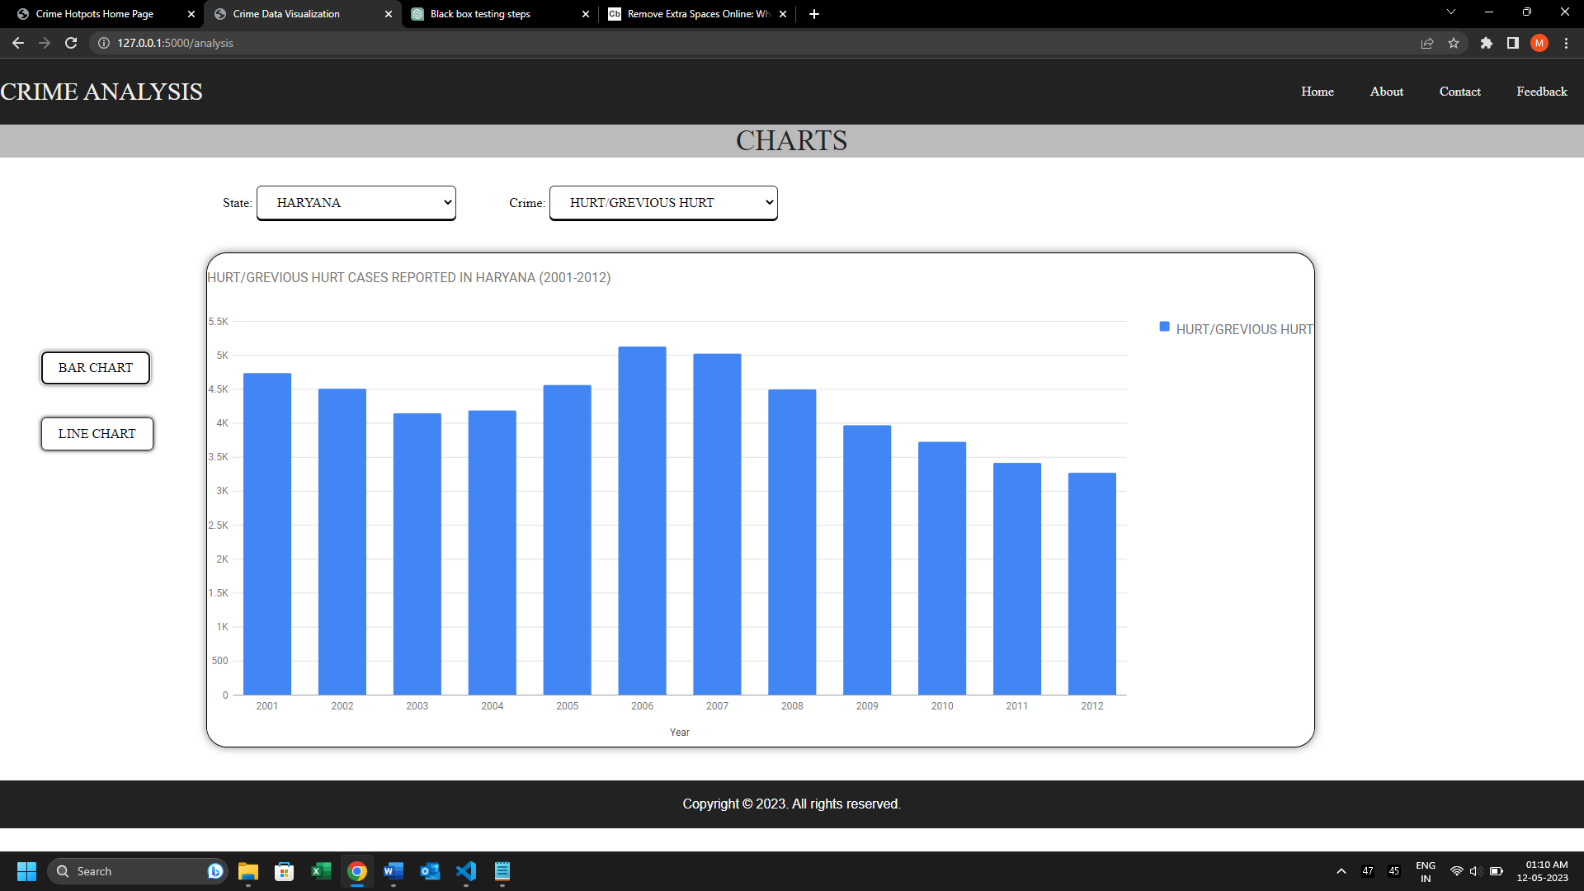
GOOGLE CHARTS SCREENSHOTS

Slide 30
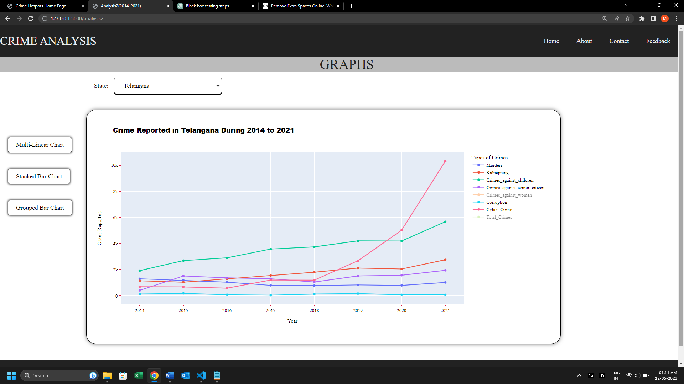
PLOTLY SCREENSHOTS (Multi-Linear)

Slide 31
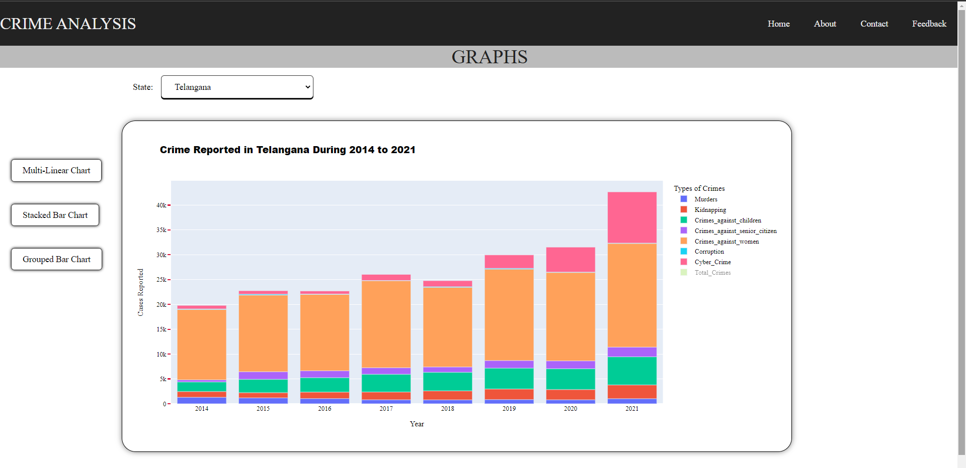
Stacked Bar Chart

Slide 32
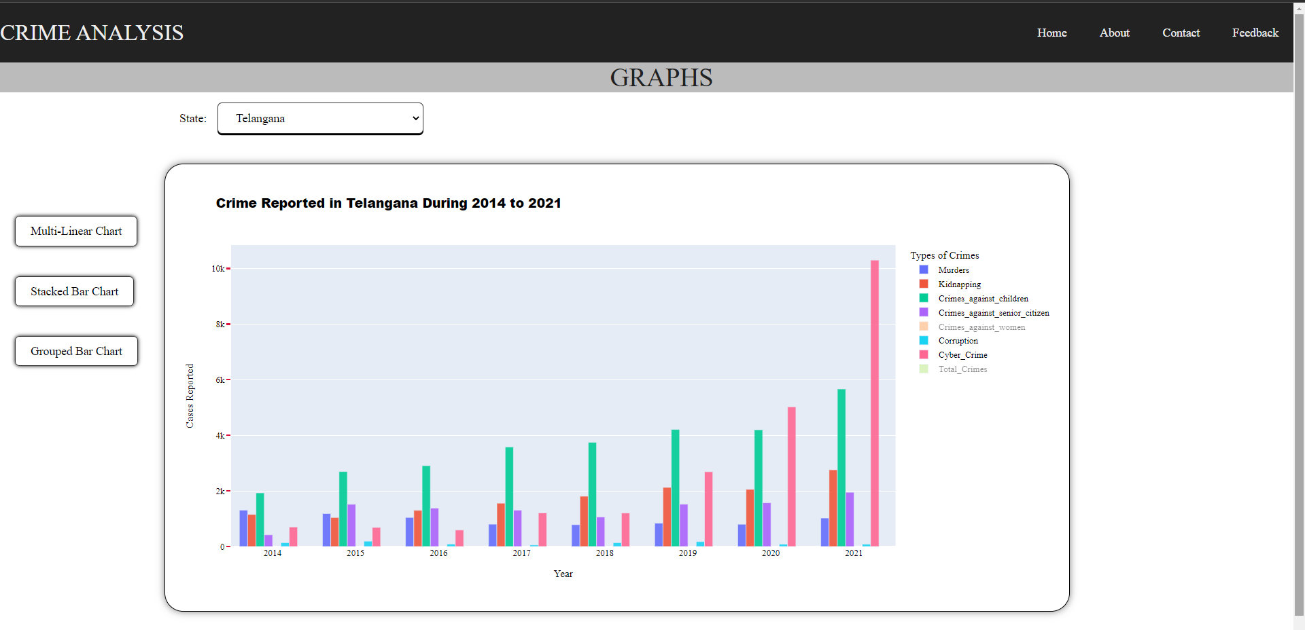
Grouped Bar Chart

Slide 33
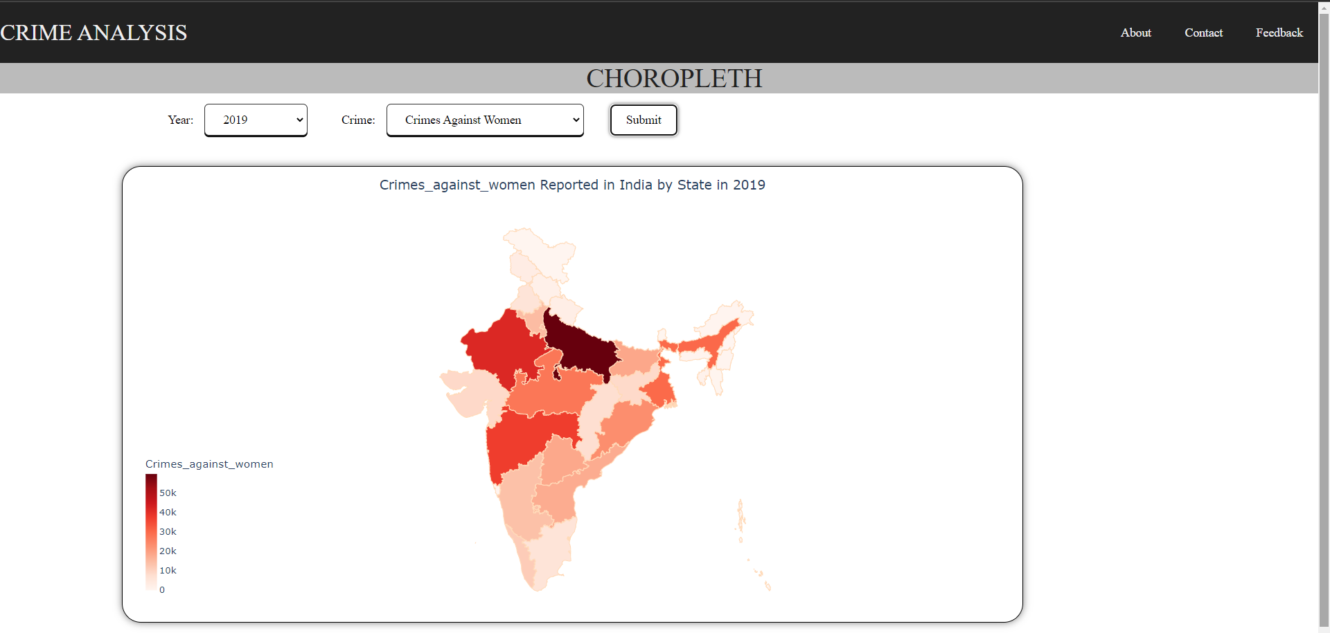
Geo-Spatial Analysis

Slide 34
WEB SCRAPING MODULE
Aim : To Provide a live visual insight into the number of crimes being committed across India. It is Achieved by using web scraping techniques to identify regions mentioned in the headlines of news websites and plotting the results onto a folium heat map.
Tools Used: (i) Beautiful Soup
(ii) Folium Map
(iii) Geo locator

Slide 35
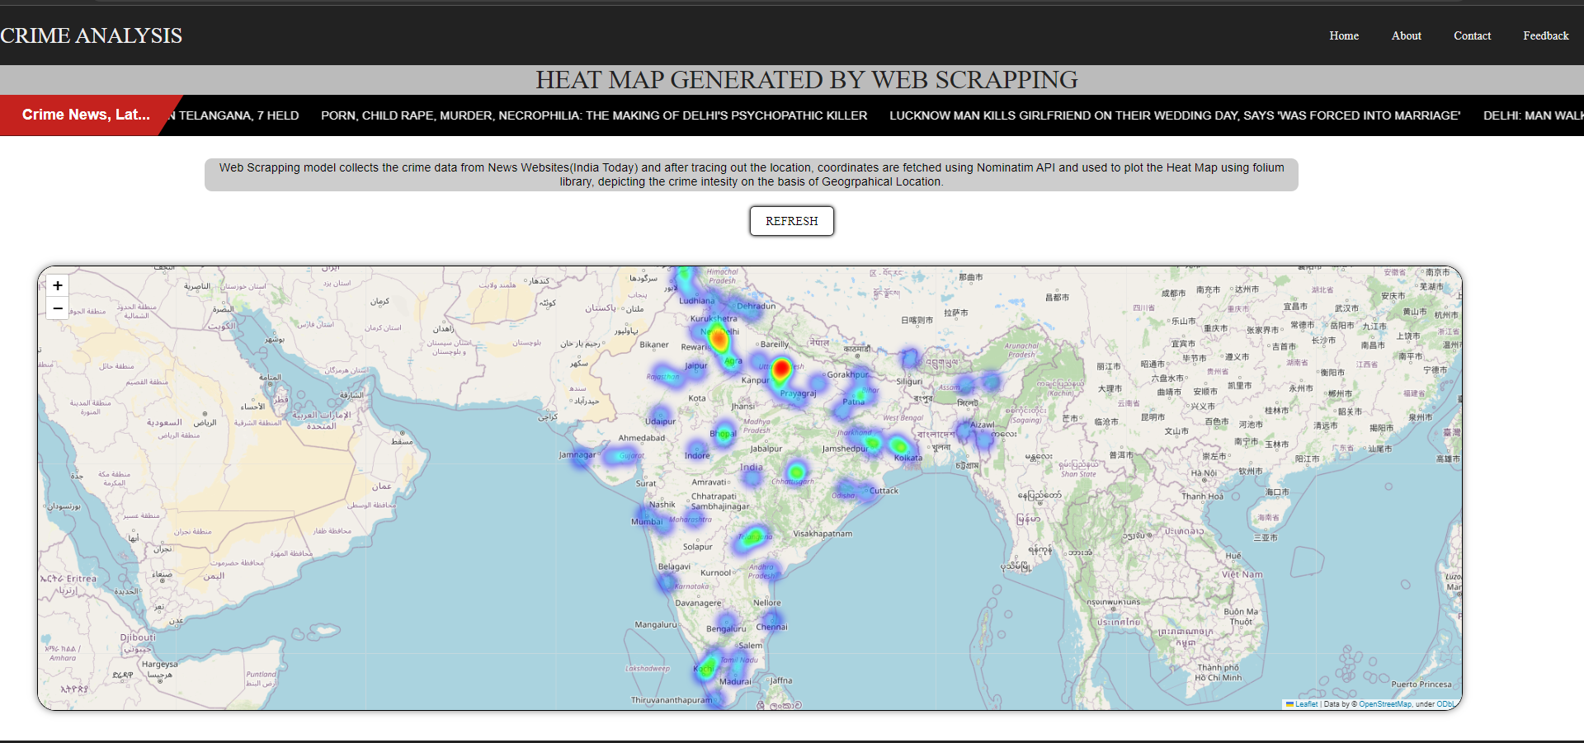
WEB SCRAPING SCREENSHOT

Slide 36
06
Testing

Slide 37
TESTING
TEST CASE | UNIT TESTING
TEST NAME | CLUSTER IDENTIFICATION
ITEMS BEING TESTED | CLUSTERING MODEL
SAMPLE INPUT | “ANDHRA PRADESH”, “HYDERABAD” (Actual input data is fetched in backend)
EXPECTED OUTPUT | RED ZONE
ACTUAL OUTPUT | RED ZONE
REMARKS | PASS

Slide 38
TESTING
TEST CASE | UNIT TESTING
TEST NAME | LABEL PREDICTION
ITEMS BEING TESTED | CLASSIFICATION
SAMPLE INPUT | “ANDHRA PRADESH”, “HYDERABAD” , 2023(Actual input data is fetched in backend)
EXPECTED OUTPUT | RED ZONE
ACTUAL OUTPUT | RED ZONE
REMARKS | PASS

Slide 39
TESTING
TEST CASE | UNIT TESTING
TEST NAME | CRIME COUNT PREDICTION
ITEMS BEING TESTED | LINEAR REGRESSION MODELS
SAMPLE INPUT | “ANDHRA PRADESH”, 2019(Actual Population input is fetched in backend)
EXPECTED OUTPUT | 237567
ACTUAL OUTPUT | 235008
REMARKS | PASS

Slide 40
TESTING
TEST CASE | UNIT TESTING
TEST NAME | CRIME RATE TEST
ITEMS BEING TESTED | FORECASTING MODEL
SAMPLE INPUT | 2021
EXPECTED OUTPUT | 269
ACTUAL OUTPUT | 268
REMARKS | PASS

Slide 41
TEST ON DATASETS
Test Data Size : 0.2 (or) 20%
Accuracy (Random Forest) = 0.9732 (or) 97.32%
Time Series Forecasting :
Accuracy (For Crime Rate): 0.8885 (or) 88.85 %
Accuracy (Total IPC Crime): 0.9666 (or) 96.66 %

Slide 42
07
Conclusion

Slide 43
Conclusion
In conclusion, this project aimed to analyze crime data and provide insights into crime patterns, trends, and hotspots.
Through visualizations the project presented the findings in a visually engaging manner, allowing users to explore and interact with the data.
The project also employed web scraping techniques to extract crime headlines and plot them on a heatmap, providing an additional perspective on crime patterns and hotspots.

Slide 44
Conclusion
The project offers valuable insights into crime analysis and can help policymakers, law enforcement agencies, and the general public to understand and address crime issues more effectively.
The techniques and methods used in this project can also be applied to other domains, such as healthcare, finance, and marketing, to extract insights from data and make informed decisions.

Slide 45
08
Future Enhancements

Slide 46
Future Scope
While the project has provided useful insights into crime analysis, there are several areas where future enhancements could be made to improve the accuracy :
It can be expanded to include more data sources like social media, police reports, etc.
It can be enhanced by incorporating advanced machine learning techniques
It can be enhanced by integrating real-time data feeds, which would allow for real-time analysis.
It can be made more accessible to the general public by developing an app that could provide real-time crime alerts, dashboards, etc.

Slide 47
09
References

Slide 48
REFERENCES
M. B. Mitchell, D. E. Brown, and J. H. Conklin, ǲA Crime Forecasting Tool for the WebBased Crime Analysis Toolkit,ǳ ʹͲͲ7 IEEE Syst. Inf. Eng. Des. Symp.,pp.ͳ– 5,2007
S.Ismail and N. Ramli,ǲShort-Term Crime Forecast ting In Keedah,ǳ Procedia-Soc. Behav. Sci., vol.91,pp.654– 660,2013.
W. Gorr and R. Harries, ǲIntroduction to crime forecasting,ǳ vol. ͳ9, pp. ͷͷͳ–555, 2003.
Ahishakiye, E., Anisha, C., Dhanashree., and , I., 2017. Crime Prediction Using Decision Tree (J48) Classification Algorithm. International Journal Computer and Information Technology, 6(03)
Sivaranjani, S., S. Sivakumari, and M. Aasha. "Crime prediction and forecasting in Tamilnadu using clustering approaches." Emerging Technological Trends (ICETT), International Conference on. IEEE, 2016.

Slide 49
Thank You !

